Slide 1




Northwind Traders
NORTHWIND TRADERS
SAIT
Data Science Project on a gourmet food supplier - Yogendran

Slide 2
AGENDA
01
Problem Statement
06
Semantic Layer of dashboard
02
Data Sourcing Strategy
07
Dashboard Visualization
03
KPI
08
Conclusion
04
Project Design
05
DAX calculations

Slide 3

PROBLEM STATEMENT
To study the products and determine which category of products are the best or worst and which country sold the highest.
Logistics is all about managing the flow of resources between point A and point B in the most efficient way possible.

Slide 4


OPEN SOURCE DATA
For this project, the dataset was sourced from Maven Analytics, specifically from their website mavenanalytics.io. This platform provides a variety of datasets suitable for data analysis and business intelligence projects, ensuring reliable and diverse data for comprehensive analysis.
DATA SOURCING STRATEGY
1. Identifying Data Requirements
2. Choosing a Reliable Data Source
3. Data Extraction
4. Ensuring Data Quality
5. Data Integration

Slide 5
KEY PERFORMANCE INDEX
KPI
JUSTIFICATION
Sales Trends
By analyzing revenue trends and sales growth, Northwind Traders can adapt their strategies, allocate resources effectively, and capitalize on emerging patterns in sales data.
Product Performance
Understanding which category food products are top-sellers helps Northwind Traders optimize their product portfolio, cater to customer needs, and focus on high profit products for maximizing revenue.

Slide 6
KEY PERFORMANCE INDEX
KPI
JUSTIFICATION
Key Customers
Analyzing customer purchasing behavior and revenue contribution allows Northwind Traders to create new marketing strategies and build strong relationships with their most valuable customers.
Shipping Costs
Monitoring shipping cost trends and identifying regions with high shipping expenses helps Northwind Traders streamline their supply chain, negotiate better deals, and enhance cost efficiency in their operations.

Slide 7
PROJECT DESIGN
Step 1: Introduction
Step 2:
Data collection
Step 3:
Data preparation
-Listing out the project goals and objectives
-Analyzing the product sales
-Source of data : Maven Analytics
-Identifying the fields, data types and data model
-Data cleaning : Handling missing values. correcting data types
-Data transformation : creating new calculated fields

Slide 8
PROJECT DESIGN
Step 4:
Data Analysis
Step 5:
Dashboard development
Step 6:
Conclusion
-Understanding the data distribution and patterns
-Applying DAX calculations for better insights
-Creating a data model and defining the relationships between tables and creating hierrachy
-Designing visualization with functionalities : charts with filters and slicers
-Summary of findings and recommendation based on analytics

Slide 9
DAX CALCULATION
This DAX calculation was used to calculate the total sales amount by multiplying the unit price by the quantity of each order item with any discounts applied.
The Average Order Value DAX calculation calculates the average value of each order by dividing the total sales amount by the number of orders.

Slide 10
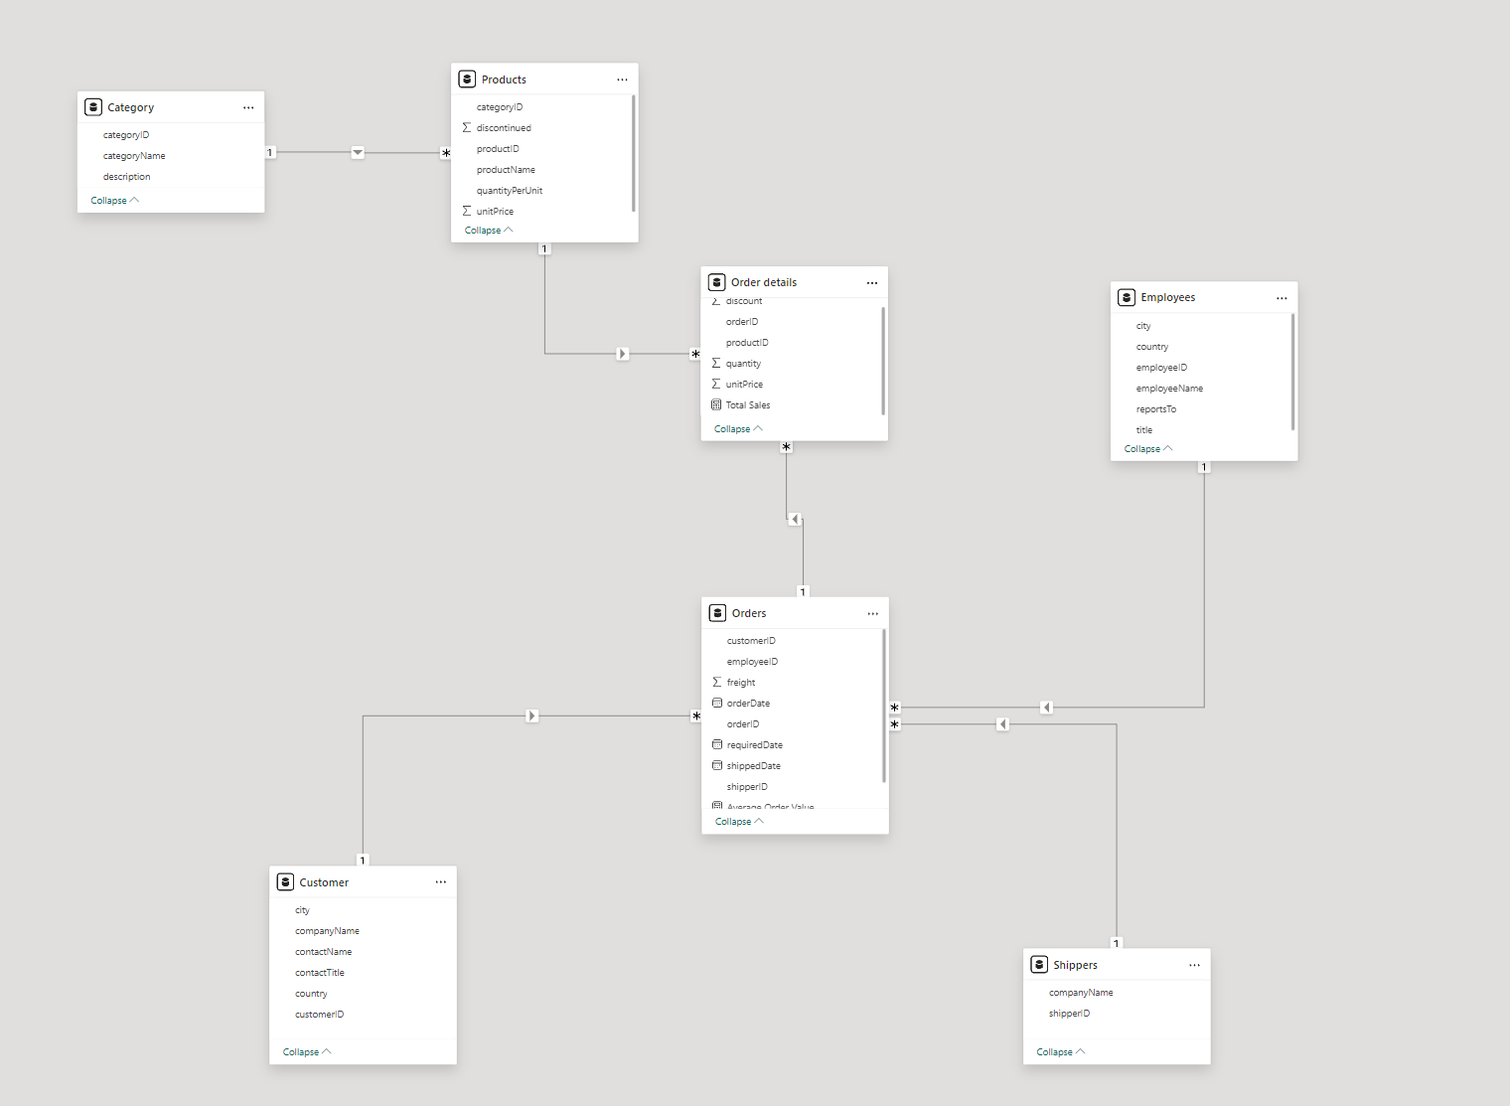
DATA MODEL

Slide 11

Product performance

Slide 12
Sales trend analysis

Slide 13

CONCLUSION
Recommendation
Summary of Analysis
Data driven decsion making is important for Northwind Traders to stay competitive in the market
Northwind Traders should improve marketing strategeis targeted at customers to improve customer satisfaction and loyalty.
Northwind Traders should also evaluate shipping methods and negotiate better rates to improve supply chain effieciency.
Power Bi dashboards enabled us to know which category of product is the highest sold which are Beverages and the lowest sold is grains and cereals.
We manage to find top 5 countries which has highest sales which is USA, Germany , Brazil , France and the UK.

Slide 14
Northwind Traders
THANK YOU

